Slide 1
National Diabetes Prevention Program: Findings from Consumer Focus Groups
May 3, 2013
Rebecca Ledsky, Research lead
Derek Inokuchi, Research support
Kristina Olson, Research support
Phillis Kim, Branding lead
Anne Quito, Design lead

Slide 2
Consumer Focus Groups
Four Markets
Philadelphia, PA
Memphis, TN
Chicago, IL
Fresno, CA
12 Focus Groups (3 per market)
6 groups with participants at-risk for diabetes
6 groups with participants with prediabetes

Slide 3
Brand Concepts
Brand name preference was evenly split
Both brand names were viewed as acceptable
A Change for Life
Perceived as hopeful and reflected the program’s lifestyle change focus
Some reported the name could be applied to addressing any condition
Some concern over the phrase “for life”
Prevent T2
Use of the word prevent was well received, but not clear what is being prevented
Good reflection of program
Some found T2 intriguing, but some were put off by having to “decode” T2

Slide 4
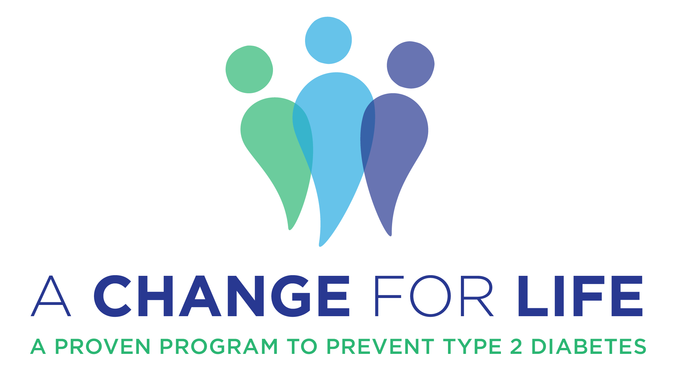
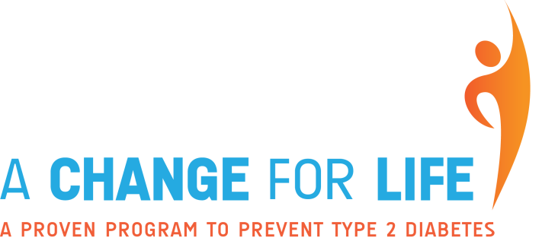
Design Elements: A Change for Life
Preferred
Mixed
Less successful

Slide 5
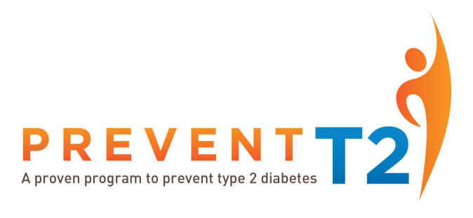
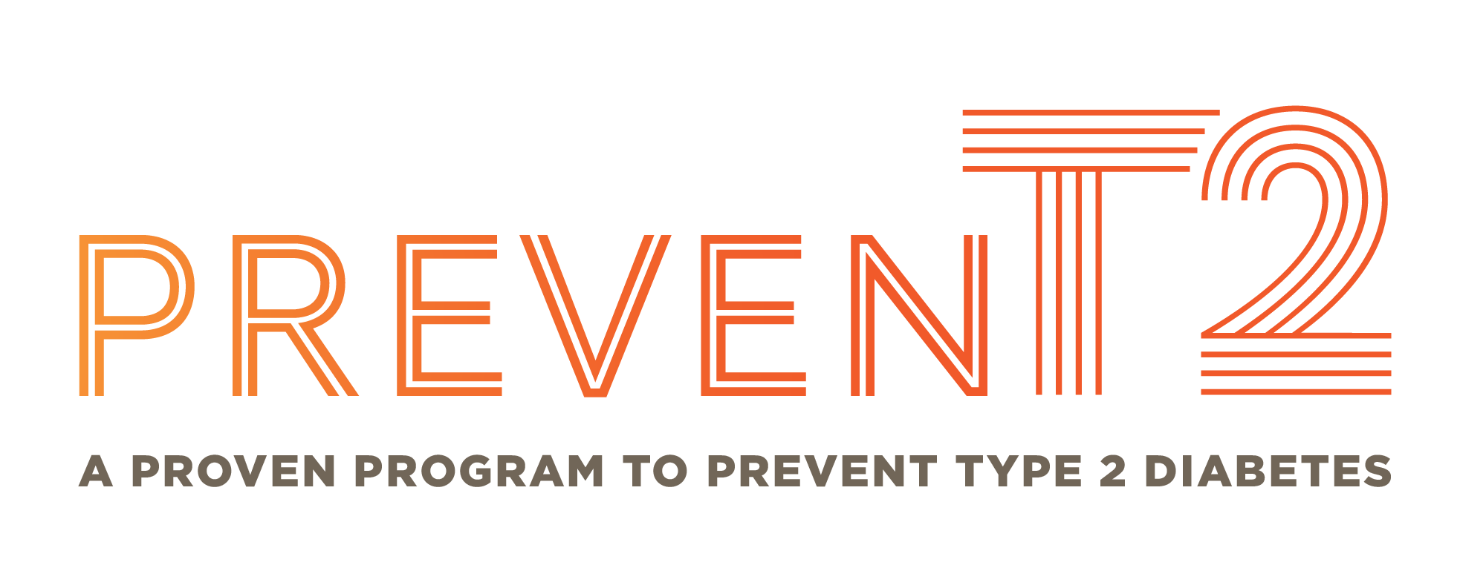
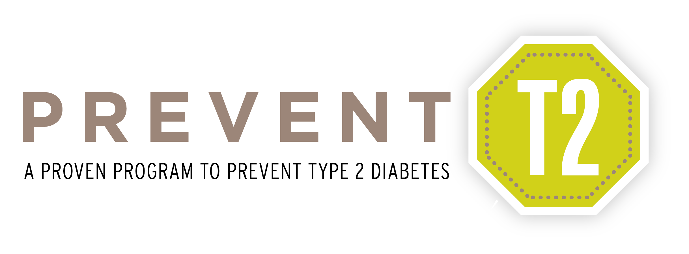
Design Elements: Prevent T2
Preferred
Mixed
Less successful
Notes:
Coalescing what was liked and not liked:
Gradated colors
Blue/Green palate – although some wanted something brighter also included (a touch of orange or yellow)
Prominent lettering – with bolding – in both logo/name and tagline
Capital, not lower case letter
swoop figure connotes energy, exercise, and victory
X figure energetic and happy
Three figures (affectionately known as the paw) conveyed a group or a family to some

Slide 6
Taglines: Preferred
Preferences
Clarifies focus on type 2 diabetes
Informational
Positive in tone
“Proven,” “Journey,” and “Together” were reported as positive words
Most well received
A proven program to prevent type 2 diabetes*
*had not received clearance on “proven” prior to focus groups (despite a request).
Notes:
Four taglines were tested:
A proven program to prevent type 2 diabetes
A proven way to keep type 2 diabetes at bay
Let’s prevent type 2 diabetes together
Start the journey to a healthier future

Slide 7
Messages: Prediabetes
Preferences
Serious, but hopeful tone
“At-Risk” groups were most interested in information about prediabetes
“Prediabetes” groups were more interested in the impacts of diabetes and information about mitigating the condition
Concerns
References to overweight and risk for healthy weight individuals
Confusion over age of individuals in target audience
Lack of clarity diabetes-related terms
Notes:
Unclear Terms: prediabetes, borderline diabetes, gestational diabetes, juvenile diabetes, differences between type 1 and type 2 diabetes

Slide 8
Messages: National Diabetes Prevention Program
Preferences
Positive tone
Approachable description of program details
“16 week program with 6 monthly follow-up sessions”
“Reducing your weight 5-7%--10 to 14 pounds for a person weighing 200 pounds…”
Peer social support and lifestyle coach support is positive
Wanted information about weekly time commitment, cost, health insurance coverage, and format (in-person)
Concerns
References to overweight and risk for healthy weight individuals
Some lack of clarity regarding the lifestyle coach
Health literacy regarding “type 2” diabetes
Notes:
Preferences
-Participants indicated it was important to know the length of the program. “Yearlong” was overwhelming and not preferred.
Concerns
-References to overweight prompted questions about prediabetes risk and diabetes prevention for healthy weight individuals.
-What is a lifestyle coach? How will lifestyle coach help?
-Some participants had questions about why this program was only for type 2 diabetes. They had questions whether type 2 diabetes was “worse” than other types of diabetes. Some would like to see more information about type 2 diabetes included in the messaging.

Slide 9
Calls to Action
Reactions
Some participants would take an online quiz, some would not
Some preferred to talk with a health care provider rather than take quiz or visit a Web site
Participants were disinclined to sign up for a program before understanding their risk and the details of the program
“Encourage” and “Learn more” were viewed as positive words
Concerns
Fear of offending friends or family as a result of encouraging them to assess their prediabetes risk
Notes:
We showed people 5 taglines:
Find out if you are at risk for prediabetes. Take the online quiz at www.cdc.gov/diabetes/prevention or talk to a health care provider.
Learn more about how the National Diabetes Prevention Program can help you reduce your risk of developing type 2 diabetes. Go to www.cdc.gov/diabetes/prevention.
Sign up today. Visit www.cdc.gov/diabetes/prevention to find a National Diabetes Prevention Program near you.
If you think you are at risk for type 2 diabetes, talk to a health care provider about getting a blood sugar test.
Encourage your family and friends who may be at risk for type 2 diabetes to take the online quiz “Could You Have Prediabetes?” at www.cdc.gov/diabetes/prevention

Slide 10
Inclusion of CDC on Materials
Positive response
Provides credibility
Differentiation from commercial weight-loss programs
Notes:
Similar findings from IDIs with grantees/coaches

Slide 11
Direction Forward
Design elements
Use blue/green colors with color gradients
Include “swoop man” graphic
Enlarge font size of tagline
Tagline
Use “A proven program to prevent or delay type 2 diabetes”*
Messages and Calls to Action
Refine for clarity and remove non-preferred words and phrases
*the phrase “or delay” negated CDC legal issues around the tagline

Slide 12
Direction Forward
Best Practice-based Brand Name Considerations
Criteria for selection: | A Change for Life | Prevent T2
Memorable (shorter is more memorable) |  | Strongest
Distinct (from other diseases programs) |  | Strongest
Distinct (from Type 1 programs) |  | Strongest
Meaning (easily related to diabetes) |  | Strongest
Emotion | Strongest
Supports brand promise |  | Strongest

Slide 13
Comments or Questions?

